Slide 1
The Healthy Student and Keeping Yourself Well
Sophie Matabaro
  Healthy Campus Officer

Slide 2

Purpose
How can you keep yourself healthy and well in Trinity?

Slide 3

What is Health?
Health is a state of complete physical, mental and social well-being and not just the absence of disease
WHO (1946)
How did we do on the previous slide?

Slide 4
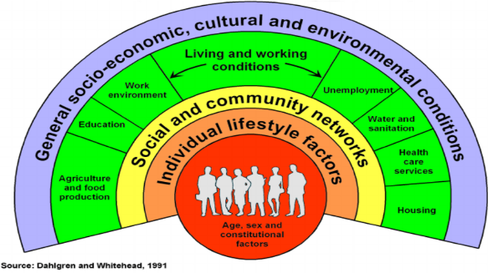
What makes us healthy?
N.B. Health is influenced by much more than individual choices
Today let’s focus on what’s in Trinity to support your health

Slide 5


Healthy Trinity
The Healthy Trinity initiative - a cross Trinity initiative with nine working groups and over 100 partners across campus.
Students welcome to contribute through:
- Working groups, assignments, ambassador programme, other.

Slide 6
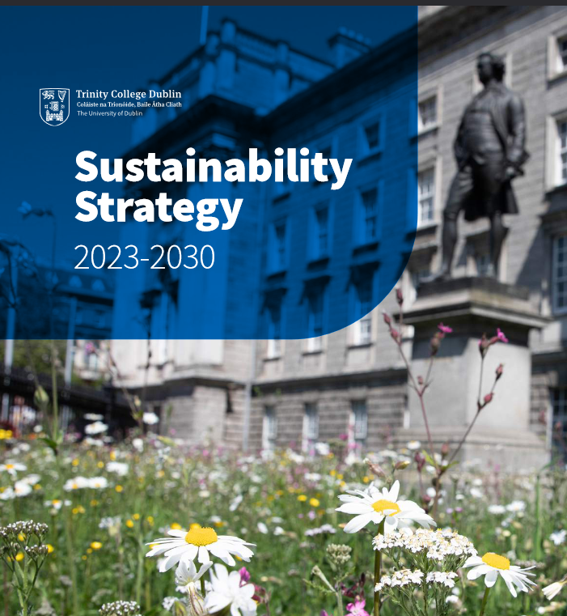
Healthy Trinity sits within the Sustainability Office
Net Zero Emissions
Nature Positive
Healthy Trinity

Slide 7

What should you do to thrive in Trinity?
Food
Physical Activity
Mental Health
Tobacco
Sexual Health

Slide 8
What should you do to thrive in Trinity?
Food
Physical Activity
Mental Health
Tobacco
Sexual Health

Slide 9
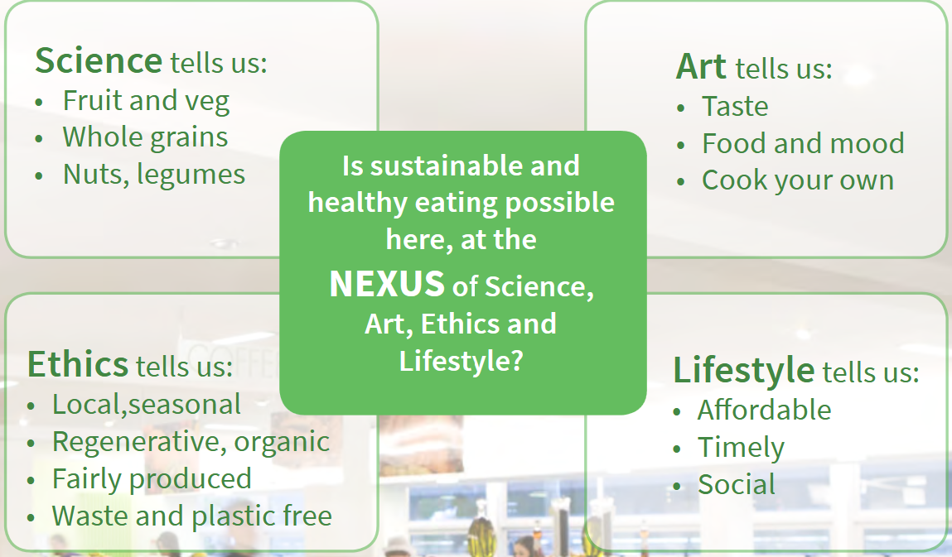
How “should” we feed ourselves

Slide 10
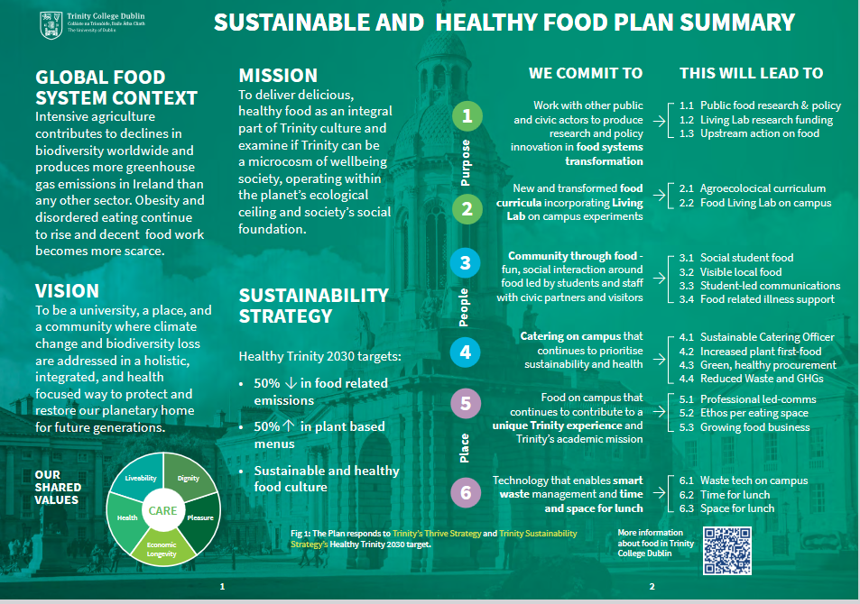

Slide 11
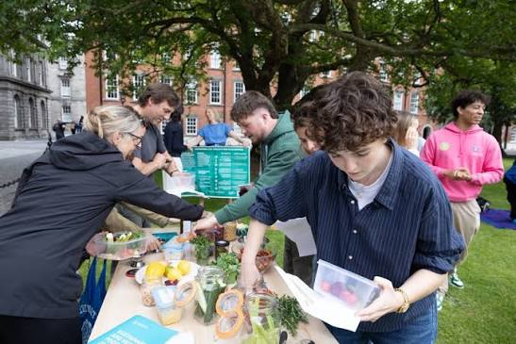
Ready, Set, Cook
www.tcd.ie/healthytrinity/eating/ready-set-cook/

Slide 12
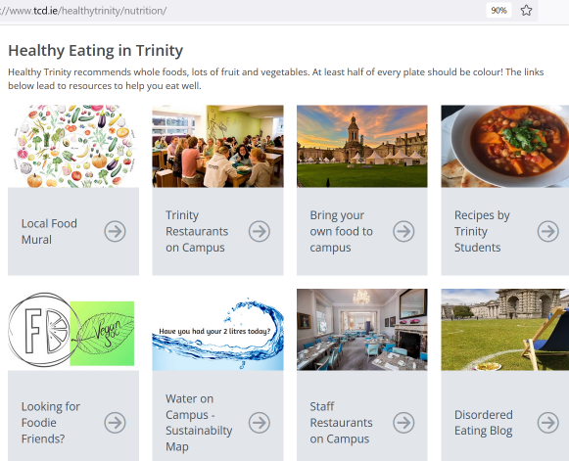
Get Organised – https://www.tcd.ie/healthytrinity/eating/
On the Healthy Trinity website can you:
Identify a place you can eat your own lunch on campus?

Slide 13
What should you do to thrive in Trinity?
Food
Physical Activity
Mental Health
Tobacco
Sexual Health

Slide 14
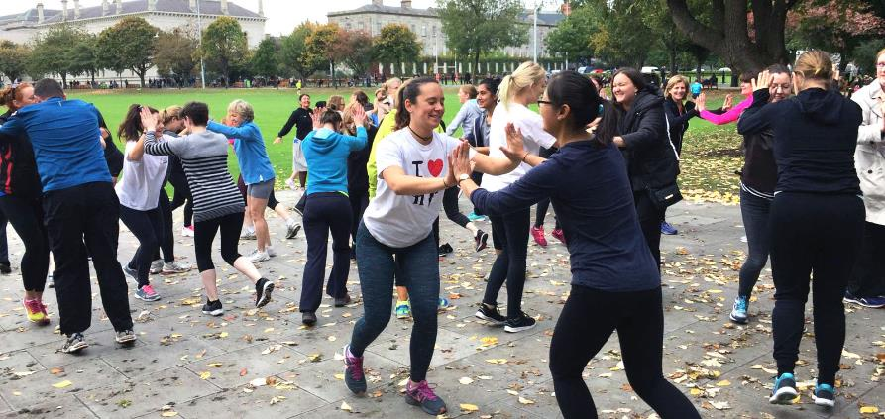
Physical Activity Recommendations
Does anyone know how much exercise you’re supposed to do a week?

Slide 15
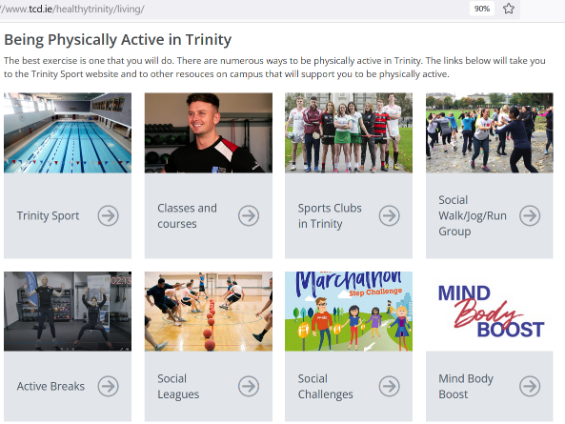
Get Organised –www.tcd.ie/healthytrinity/physical-activity/
On the Healthy Trinity website:
What Sports Club have you always wanted to try, and might just join now?

Slide 16

Exercise (for non-sporty students!)
Get a bike
7 minute workouts
Couch to 5k programmes
Take the stairs
30 minutes a day is all you need… and move all day
Walk
What exercise are you most likely to keep doing, even approaching deadlines?

Slide 17
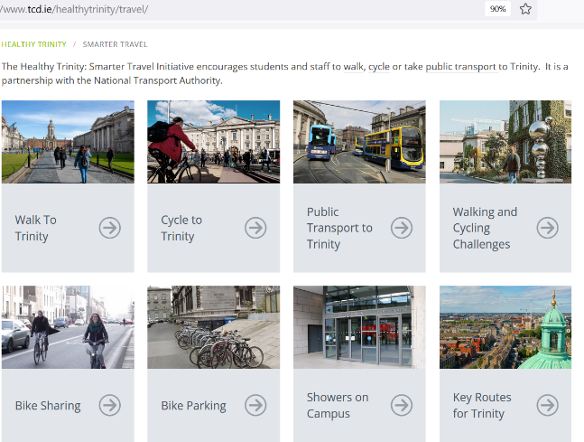
Get Organised –www.tcd.ie/healthytrinity/smarter-travel/
On the Healthy Trinity website can you:
Find what type of bike sharing Trinity has?

Slide 18
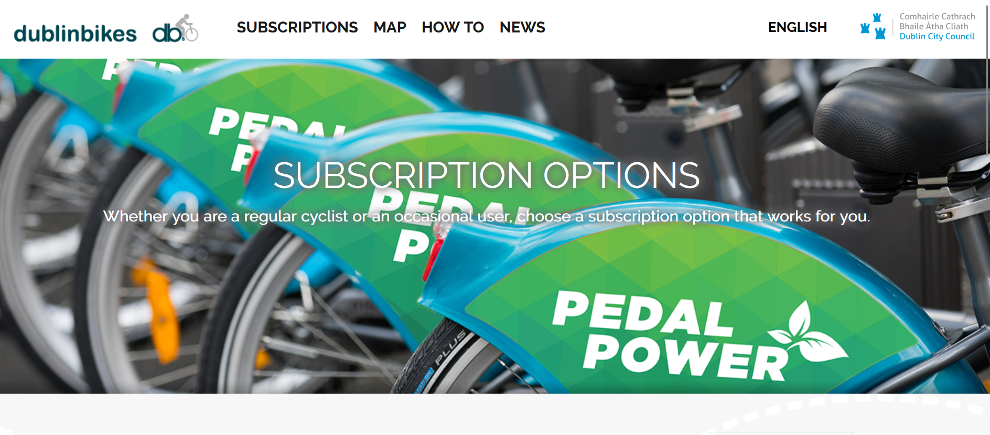
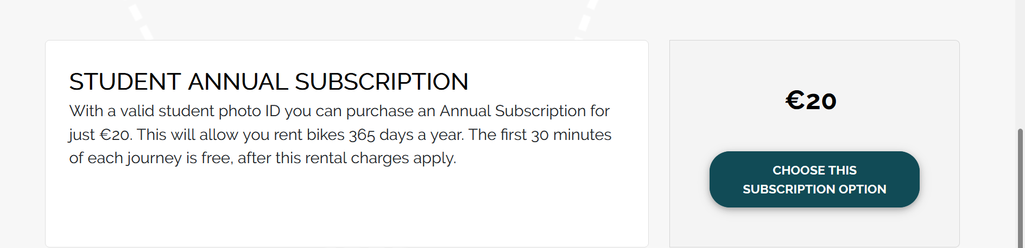
Dublin Bikes

Slide 19
What should you do to thrive in Trinity?
Food
Physical Activity
Mental Health
Tobacco
Sexual Health

Slide 20
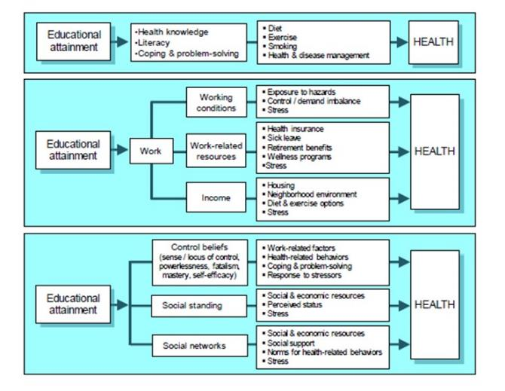
Education is to the brain, what exercise is to the body
Notes:
How education promotes health throughout the life course
From Robert Wood Johnson foundation report 2011

Slide 21
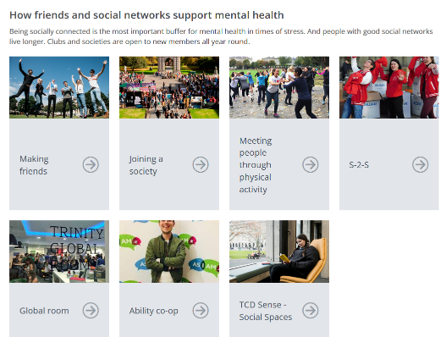
Get Organised – https://www.tcd.ie/healthytrinity/mentalhealth/
On the Healthy Trinity website can you:
Identify how many slices are on student counselling service’s overview?
PLEASE, ask for help if you need it.

Slide 22
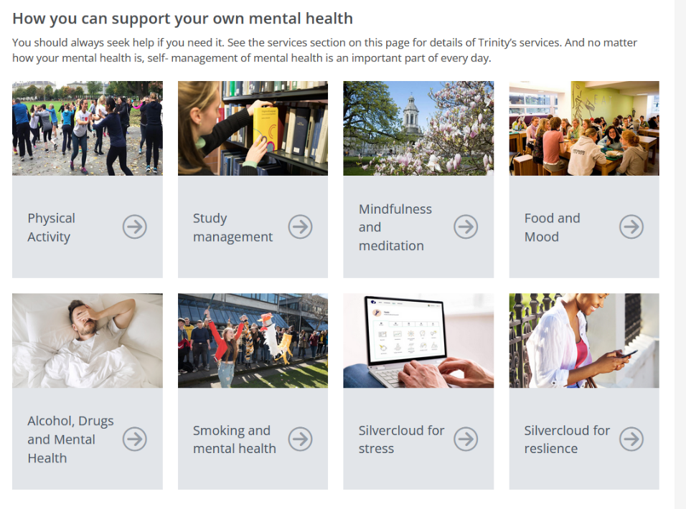
Managing your own mental health

Slide 23
Get Organised – https://www.tcd.ie/healthytrinity/mental-health/
On the Healthy Trinity website can you:
How many levels of mental health are there?
PLEASE, ask for help if you need it.

Slide 24

Question to the group
What is the primary protective factor from crises consistently recognised in both research and evidence based practice
HSE Guidance Document 2014

Slide 25
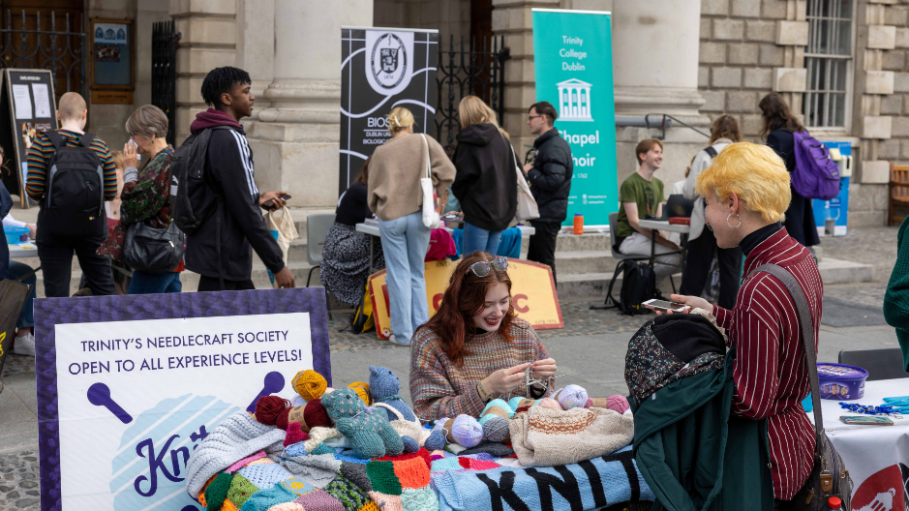
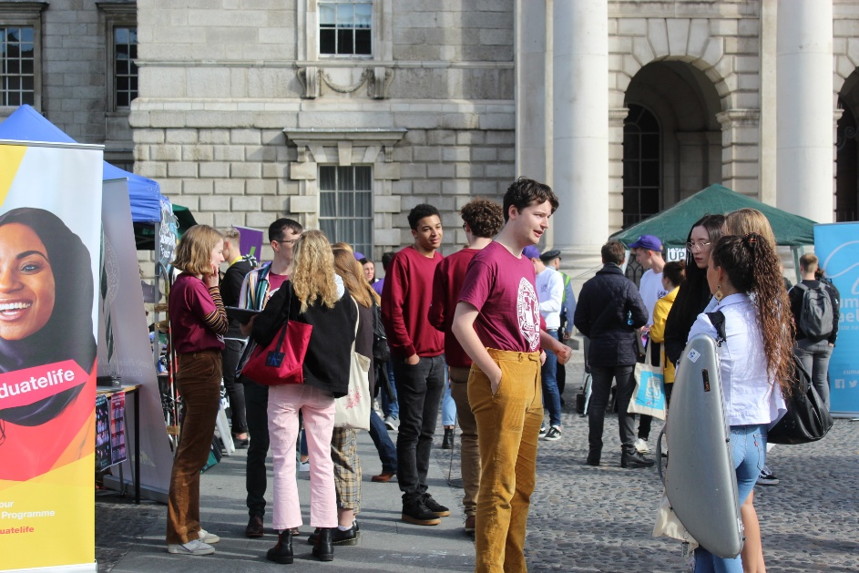

Social supports
The primary protective factor consistently recognised in both research and evidence based practice is that of social supports.
Buffer the effects of stress
Can reduce the prevalence of distress and psychological symptoms, including depression and anxiety
Lack of social support proved to be one of the strongest risk factors for PTSD
Generally, Social isolation associated with:
  depression, anxiety, schizophrenia, suicide, dementia, Alzheimer's disease

Slide 26

Get Organised – www.tcd.ie/students/clubs-societies/
On the Student Life website can you:
In pairs, choose a club or society you would never normally join?

Slide 27
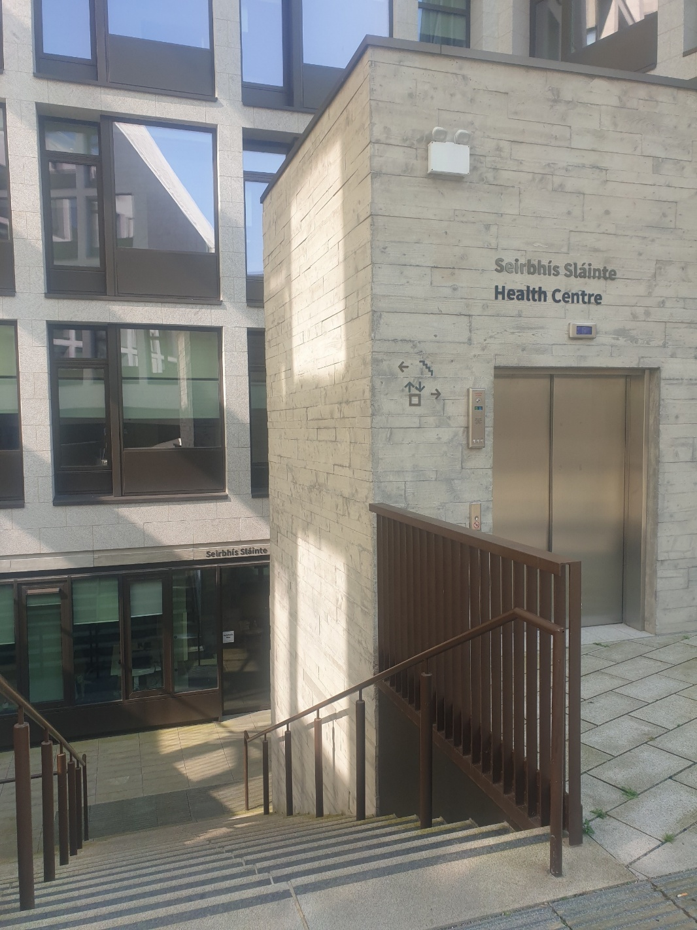
Get Organised – www.tcd.ie/collegehealth
On the College Health website can you:
Figure out how to book an appointment for mental health?
PLEASE, ask for help if you need it.

Slide 28
What should you do to thrive in Trinity?
Food
Physical Activity
Mental Health
Tobacco
Sexual Health

Slide 29
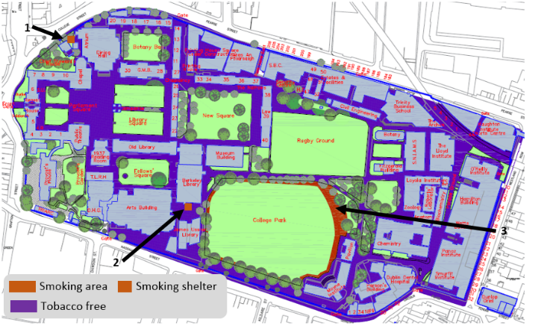
Tobacco – Trinity is a tobacco free campus
Ongoing support to quit
50% of smokers in Trinity start at >18 years of age.
Will you start smoking in Trinity?

Slide 30
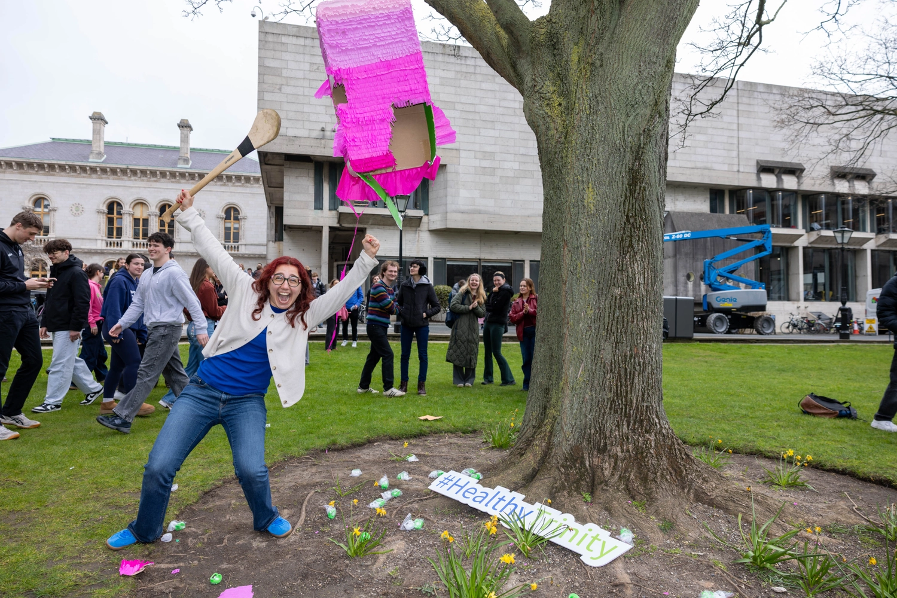
Vaping on campus
Show of hands
Should vaping be allowed outdoors on campus?
Disposable vapes to be banned by government

Slide 31
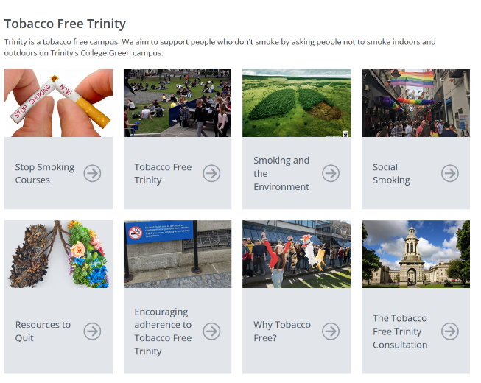
Get Organised – https://www.tcd.ie/healthytrinity/smoking/
On the Healthy Trinity website can you:
Find where the smoking areas are on campus?

Slide 32
What should you do to thrive in Trinity?
Food
Physical Activity
Mental Health
Tobacco
Sexual Health

Slide 33
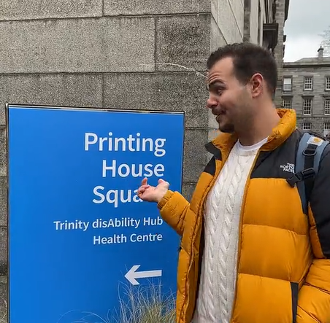

HSE Free Contraception Scheme
College Health delivers the HSE Free Contraception scheme to
PPS holders
Age 17-35
The Coil, the Pill, Implanon
Book online
Click image to see tik tok
Notes:
Encourage to apply for PPS asap.
All contraception is free and we offered all types including coil (hormonal and copper) and implanon.
We are hoping to have the booking system on the website very soon but they can make appt at desk/by phone for now.

Slide 34
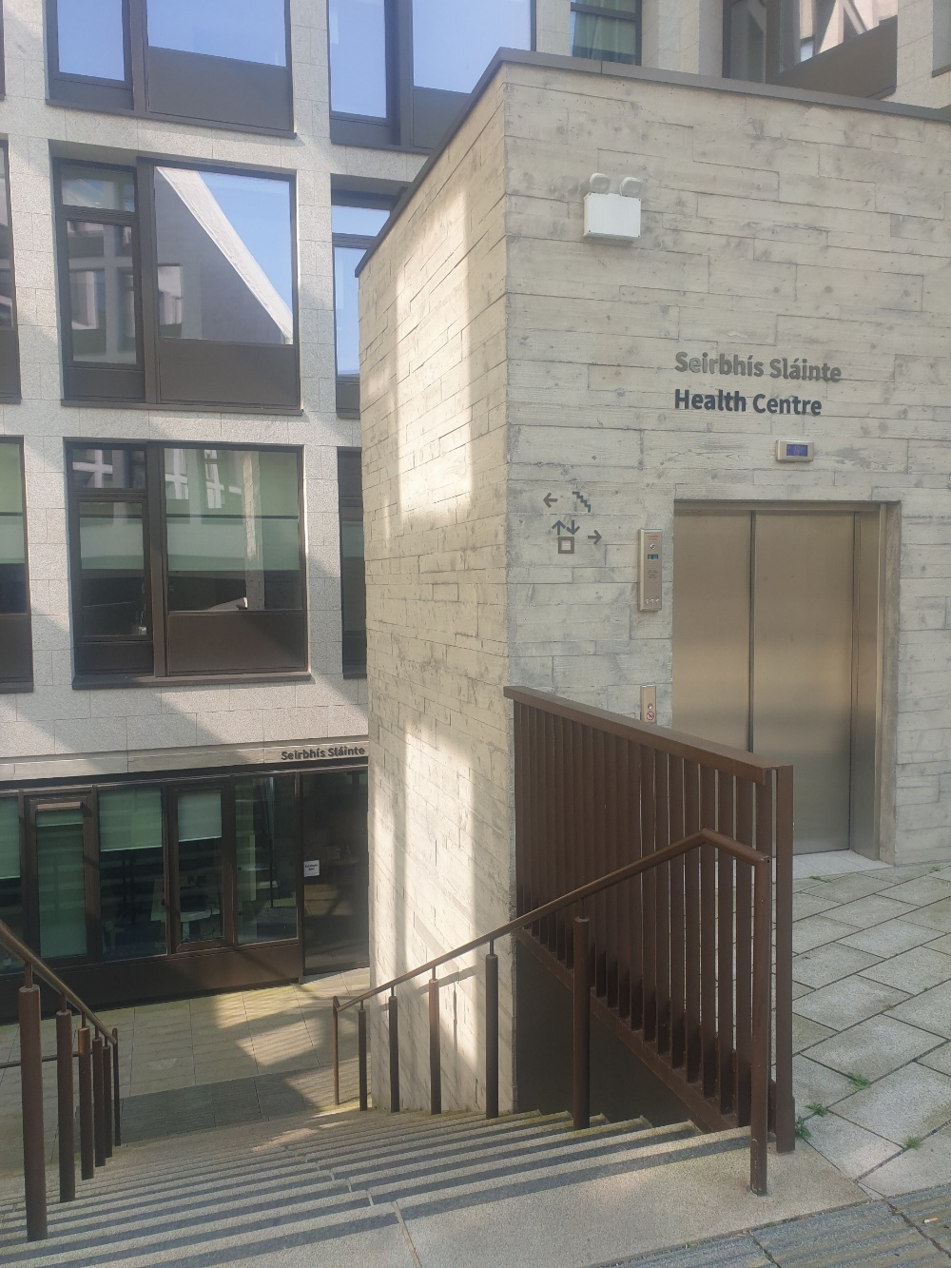
College Health
Open 9am-5pm
Emergency clinics
For UTIs, eye infection, mental health crises medical emergencies, not routine e.g. prescription renewal
Morning: Phone at 9am to book
Afternoon: Phone at 12pm to book
Routine appointments
Two week waiting list

Slide 35
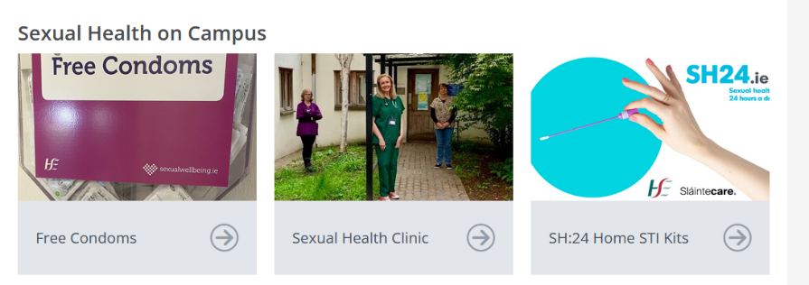
Get organised - https://www.tcd.ie/healthytrinity/sexual-health/
On the Healthy Trinity website can you:
Find where you can book free contraception?

Slide 36

Healthy Trinity Online Tool
Notes:
I have given a flash tour. For those who love this, check out the HTOT.
The aim of the Healthy Trinity Online Tool is to help you focus on the importance of maintaining work-life balance throughout your degree and into your career. This tool has been developed in partnership with academics, operational staff and students within Trinity. The content is based on the latest evidence and include practical advice and guidance from the outset. There is a wide variety of topics that you will find helpful.
The Healthy Trinity Online Tool is available for all undergraduate and postgraduate students in Trinity!
To access the Healthy Trinity Online Tool use Google Chrome as your web browser; Login to Blackboard in the usual way, and scroll down to the ‘Assist’ tab on the left hand side, find the ‘Healthy Trinity Online Tool’, on the left-hand side click ‘Enrol’, then click ‘Submit’ and click ‘Ok’.
Once you have enrolled in the Healthy Trinity Online Tool, you can re-access it in the same place as you get your module.
The aim of the Healthy Trinity Online Tool is to help you focus on the importance of maintaining work-life balance throughout your degree and into your career. This tool has been developed in partnership with academics, operational staff and students within Trinity. The content is based on the latest evidence and include practical advice and guidance from the outset. There is a wide variety of topics that you will find helpful

Slide 37

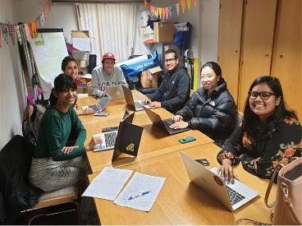

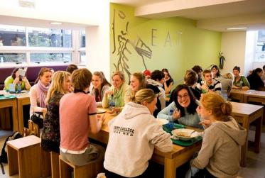



Thank you and stay in touch with Healthy Trinity
@HealthyTrinityDublin
health.promotion@tcd.ie

